Slide 1

Ist645: Module 12
Group 4

Slide 2
The Importance of Project Procurement
What is procurement?
Procurement is acquiring goods or services from an outside source. This may be called purchasing or outsourcing depending on the nature of the organization.
Vendors/Suppliers/Contractors/Sellers are the individuals who provide the procurement services.
The procurement activities make use of Request for Proposals and Contracts to specify requirements and indents to be floated to the suppliers.
Each organization may have a different procurement cycle, but the end goal is to understand what, when,where and how to outsource.

Slide 3
How does outsourcing help?
Access skills and technologies: Helps in gaining access to specific skills and technologies that are provided by external resources.
Reduce both fixed and recurrent costs: It may be less expensive to outsource some labour costs to other organizations in the same country or offshore. This also helps companies reduce labour costs on project thus avoiding laying off or reassigning people to projects.
Allow the client organization to focus on its core business: Many organization’s core domain may not be IT and yet they have spent their valuable time and resources on IT functions. Outsourcing helps them in being focused on their core competencies.

Slide 4
How does outsourcing help?
Provide Flexibility: Outsourcing to provide extra staff during periods of peak workloads can be very helpful and avoids reorganizing the staff or overburdening existing employees. Apple says it could not produce several of its products fast enough without outsourcing.
Increase accountability: A contract often plays part of a legal document that is well structured. It is a mutually binding agreement that obligates the seller to provide services as specified and obligates the buyer to pay them. This ensures accountability.

Slide 5
Processes in Project Procurement Management
Planning Procurement Management: Involves determining what, when and how to procure. One must decide what to outsource and determine the type of contract and describe the work for potential sellers.
Conducting procurements: Involves obtaining seller responses, selecting sellers and awarding contracts.
Controlling procurements: Involves managing relationships with sellers, monitoring contract performance, making changes as appropriate, and closing out contracts.

Slide 6
Planning Procurement Management
Planning procurement management involves determining the project needs and deciding WHAT, HOW MUCH and WHEN to procure.
This is often facilitated with the help of a contract that specifies all the needs such as quantity, delivery time and nature of services or goods.
The contract is a mutually agreed legally binding document.
Each organization may have a different procurement cycle however contract or a Request for Proposal (RFP) is where the cycle is initiated.

Slide 7
Types of Contracts Fixed or lump-sum, Cost Reimbursable, Time and Material
Fixed or lump-sum Contracts:
Involves a fixed total price for a well-defined product or service.
Incurs very less risk to the buyer as the price is predetermined.
The seller often pad their estimate to reduce their risks although providing a competitive bid.
The contract could also include incentive fee. Example where incentives can be applied: A printer needs to be delivered in two month. If the supplier can expedite the process and is able to deliver the same within a month, they may charge an incentive.

Slide 8
Types of Contracts Fixed or lump-sum, Cost Reimbursable, Time and Material
Fixed or lump-sum Contracts:
Firm-Fixed-Price (FFP) contract has the least amount of risk for the buyer.
This is often followed by a fixed-price incentive fee (FPIF) contract.
The fixed-price with economic price adjustment contract (FP-EPA) includes maintains the scope for predefined final adjustments to the contract price due to change in conditions such as inflation etc.
An FP-EPA contract protects both the buyer and the seller from external conditions that are beyond their control.

Slide 9
Types of Contracts Fixed or lump-sum, Cost Reimbursable, Time and Material
Fixed or lump-sum Contracts:
Contracts can also include incentives to prevent or reduce cost overruns.
The U.S. Federal Acquisition Regulation (FAR) calculates a fixed-price incentive fee contract as below:
PTA
CP TP
Govt. Share
TC
Point of Total Assumption
CP: Ceiling Price
TP: Target Price
TC: Target Cost

Slide 10
Types of Contracts Fixed or lump-sum, Cost Reimbursable, Time and Material
Cost Reimbursable Contracts:
Involves payment to the supplier for direct and indirect actual cost.
Direct costs are the costs incurred to produce the project’s products and services. They can be traced back to a project in a cost-effective way.
Indirect costs are the costs that are not directly related to the products or services of the project but affect the performance of the project. These costs can be traced back.
Four types of Cost Reimbursable Contracts: Cost Plus Incentive Fee (CPIF), Cost Plus Fixed Fee (CPFF), Cost Plus Award Fee(CPAF) and Cost Plus Percentage of Costs(CPFF)

Slide 11
Cost Reimbursable Contracts:
Cost Plus Incentive Fee (CPIF): The buyer pays the supplier for allowable costs as defined in the contract along with a predetermined fee and incentive bonus.
Cost Plus Fixed Fee (CPFF) : The buyer pays the supplier for allowable costs as defined in the contract and a fixed fee payment that is usually based on a percentage of estimated costs. The fee does not vary unless the scope of the contract changes.
Types of Contracts Fixed or lump-sum, Cost Reimbursable, Time and Material

Slide 12
Types of Contracts Fixed or lump-sum, Cost Reimbursable, Time and Material
Cost Reimbursable Contracts:
Cost Plus Award Fee (CPAF) Contract: The buyer pays the supplier for allowable costs as defined in the contract plus as an award fee on the satisfaction of subjective performance criteria.
Cost Plus Percentage Costs (CPCC) Contract: The buyer pays the supplier allowable costs as defined in the contract along with a predetermined percentage based on total costs. This is least desirable type of contract for a buyer.

Slide 13
Types of Contracts Fixed or lump-sum, Cost Reimbursable, Time and Material
Time and Material:
It is a hybrid of fixed-price and cost-reimbursable contracts.
This type of a contract is often used in a contract where the work cannot be specified clearly and total costs cannot be estimated in a contract.
Unit Pricing:
It is used in various types of contracts to require the buyer to pay the supplier a predetermined amount per unit of product or service.

Slide 14
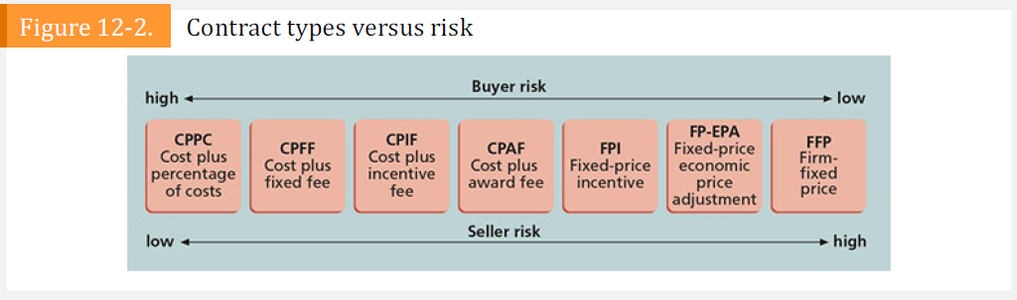
Contract Types vs Risks

Slide 15
Tools and Techniques for Planning Procurement Management
Make-or- buy analysis: It is used to determine whether the organization should make a product or perform service inside the organization or purchase from elsewhere.
Expert Judgement: Experts both internally within the organizations and outside provide strategic advice in planning purchases and acquisitions. Project teams often consult experts as a part of good business practice.
Market Research : Procurement team needs to evaluate several vendors in the market that provide the same services or products. So, they must choose suppliers carefully. Some organizations maintain a preferred vendor list and detailed information about them.

Slide 16
Procurement Management Plan
Describes how the procurement processes will be managed- from developing documentation to contract closure.
Procurement management plan will vary with project needs.
Some things that will be included in the plan.
Guidelines for types of contracts
Standard Procurement documents or Templates
Guidelines for creating contract work breakdown structures
Roles and responsibilities of the project team
Suggestions for managing multiple providers
Constraints and assumptions related to purchases
Risk mitigation strategies for purchases and acquisitions- bonds

Slide 17

Statement of Work
Statement of work (SOW) is a description of the work required for the procurement
SOW is used to describe only the work required for a particular contract, it is called a contract statement of work
The contract SOW is a type of scope statement that describes the work to allow prospective suppliers to determine if they can provide the required goods
It is important to use appropriate wording in a contract SOW
For the operating system conversion project- company should specify the manufacturer and model number for the hardware involved, the former operating systems and new ones for the conversion, and the number of pieces of each type of hardware involved.
The contract SOW should also specify the location of the work, the expected period of performance, specific deliverables

Slide 18
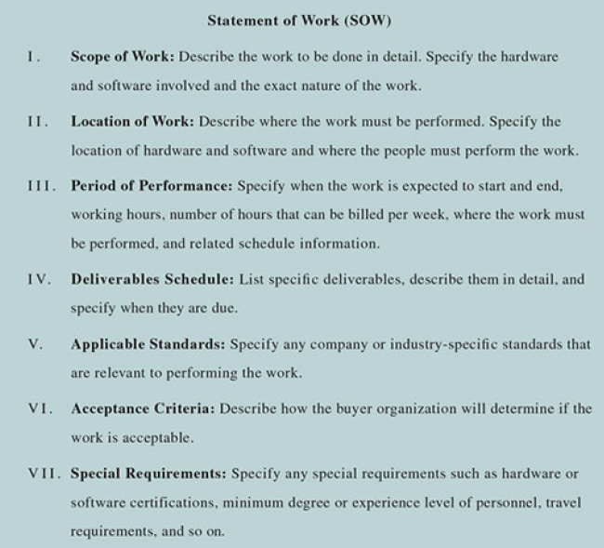

Slide 19

Procurement or Bid Documents
Planning procurements also involves preparing the documents needed for potential sellers to bid on a project and determine the evaluation criteria for the contract award.
There are a few examples of procurement documents
Request for Proposal (RFP)- A Request for Proposal (RFP) is a document used to solicit proposals from prospective suppliers. A proposal is a document prepared by a seller when there are different approaches for meeting buyer needs. Request for Quote (RFQ)-
A Request for Quote (RFQ) is a document used to solicit quotes or bids from prospective suppliers.
A bid , also called a tender or quote (short for quotation), is a document prepared by sellers to provide pricing for standard items that the buyer has clearly defined.
Request for Information (RFI)-
A Request for Information (RFI) is sometimes used before issuing an RFP or RFQ to get more information on the goods and services to be acquired.

Slide 20
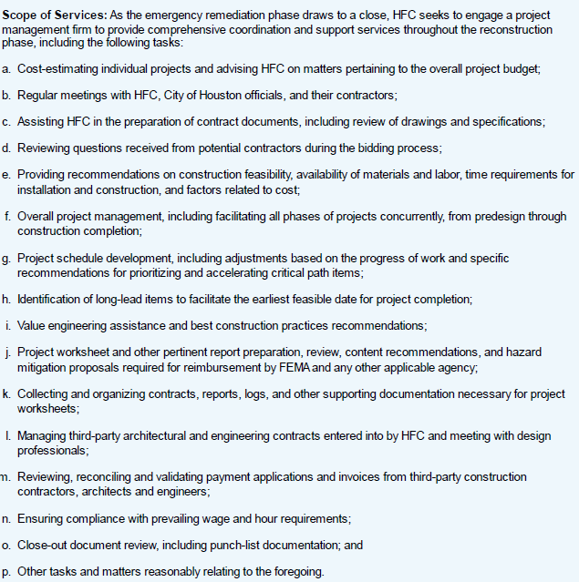
Examples from a Real RFP
Government agencies are often required to make procurement information open to the public. RFP issued in October 2017 for project management services to assist the organization in overseeing rebuilding after flooding from Hurricane Harvey.
It had things like
Purpose of RFP:
Scope of Service :
As the emergency remediation phase draws to a close, HFC seeks to engage a project management firm to provide comprehensive coordination and support services throughout the reconstruction phase
Term/ Schedule Information
Proposal Format: Transmittal Letter, Project Team, Experience, Pricing, Diversity
Even though the RFP is pretty detailed, there were several questions submitted from potential proposers.
As a result, HFC issued three letters of clarification. It included a proposal format, pre-proposal conference and project questions and answers.

Slide 21
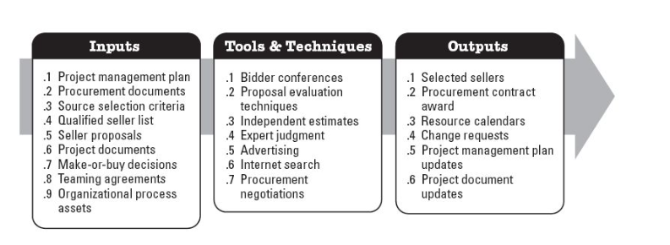
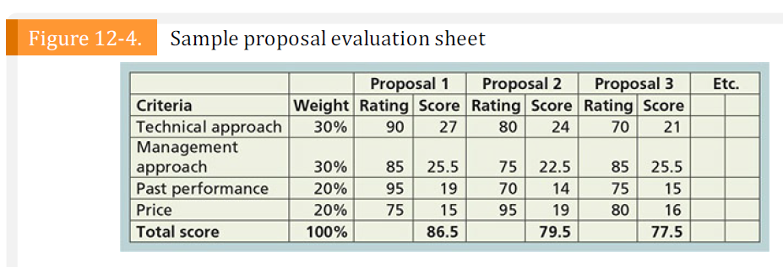
Conducting procurements is the process of obtaining seller responses, proposals or bids, selecting a seller, and awarding a contract
Source selection criteria is a set of attributes desired by the buyer which a seller is required to meet or exceed to be selected for a contract
Two main end results of this process are a selected seller and agreements
Conduct Procurements​
Reference: https://3434teama.weebly.com/project-procurement-management.html​​

Slide 22
Controlling procurements ensures that the seller’s performance meets contractual requirements
Project managers and team members must watch for constructive change orders
Good practices related to project procurement:
Changes to any part of the project need to be reviewed, approved, and documented by the same people in the same way they approved the original part of the plan
Evaluation of any change should include an impact analysis
How will the change affect the scope, time, cost, and quality of the goods or services being provided?
Changes must be documented in writing (document all important meetings and telephone calls)
When procuring complex information systems, project managers and their teams must stay closely involved to make sure the new system will meet business needs and work in an operational environment
Have backup plans in case the new system does not work as planned
Tools and techniques can help in contract administration - such as a formal contract change control system, buyer-conducted procurement performance reviews, inspections and audits, performance reporting, payment systems, and records management systems
Control
Procurements

Slide 23
Closing procurements is also called as contract closure which involves completion and settlement of contracts and resolution of any open items
The project team should update records to reflect results and archive information for future use
Tools to assist in contract closure:
Procurement audits and negotiated settlements
Procurement audits are often done during contract closure to identify lessons learned in the entire procurement process.
A records management system provides the ability to easily organize, find, and archive procurement-related documents
Close
Procurements

Slide 24
Using Software to Assist in Project Procurement Management
Many companies are now using more advanced software to assist in procurement management. The term e-procurement often describes various procurement functions that are now done electronically, as follows:
Web-based ERP (Electronic Resource Planning)
E-MRO (Maintenance, Repair, and Overhaul)
E-sourcing
E-tendering
E-reverse auctioning
E-informing
E-marketsites

Slide 25
Using Software to Assist in Project Procurement Management
One type of software that is particularly useful for streamlining procurement is the procure-to-pay suite, which provides support for indirect procurements.
Unlike direct procurement, where procurement experts in organizations acquire raw materials and goods for production or services related to their organization’s primary business, indirect procurement involves acquiring supplies and services required to keep the day-to-day business functioning, such as equipment repairs, office supplies, and services related to keeping business processes running.
Their qualitative analysis of the procure-to-pay suites market makes the point that because self-service software tools are available, employees at all levels of an organization can buy goods and services without the need for professional procurement expertise. This streamlines the process for indirect procurements, so that procurement experts can focus on the more strategic direct procurements. The four main capabilities of procure-to-pay suites for indirect procurements include the following:
E-purchasing functionality
Catalog management capabilities
E-invoicing
Accounts Payable Invoice Automation (APIA)

Slide 26
Considerations for Agile/Adaptive Environments
In agile environments, specific sellers may be used to extend the team.
Larger projects may use an adaptive approach for some deliverables and a more stable approach for other parts. In these cases, a governing agreement such as a master services agreement (MSA) may be used for the overall engagement, with the adaptive work being placed in an appendix or supplement. This allows changes to occur on the adaptive cope without impacting the overall contract.
Recall that the Agile Manifesto values customer collaboration over contract negotiation, setting an important tone for procurement relationships on agile projects.
Another goal of agile/adaptive environments is speed.
The processes of project procurement management follow a clear, logical sequence.
If projects will benefit by procuring goods or services, then project managers and their teams must follow good project procurement management.

Slide 27
The End
Are there any questions we can address?

